Slide 1
Indoor Air Quality
Basic Management for Healthy Office Environments
Peter A Shelling CSP CIEC
Notes:
CSP = Certified Safety Professional CIEC = Certified Indoor Environmental Consultant.

Slide 2
Why is Indoor Air Quality (IAQ) a problem now?
People spend more time indoors than ever before
(90% for most Americans.)
Building design and materials
Energy efficiency
‘Green’ building principles
Cheaper materials
Notes:
Green building principles and energy conservation are not going away. However they have some disadvantages, of which we need to be aware so they can be managed properly.

Slide 3
“I am persuaded that no common air from without is so unwholesome as the air within a closed room that has been often breathed and not changed”
-Benjamin Franklin
Notes:
There have been IAQ problems as long as there have been buildings.

Slide 4
Sick Building Syndrome
sick build·ing syn·drome
Noun
noun: sick building syndrome
a condition affecting office workers, typically marked by headaches and respiratory problems, attributed to unhealthy or stressful factors in the working environment such as poor ventilation.
Notes:
Sneezing, scratchy throat, itchy, watery eyes– all go away when person leaves building

Slide 5
Building- related illness
Evidence that IAQ has a direct relation to specific illness.
-Hypersensitivity pneumonitis
-Asthma
-Legionnaire's disease
Notes:
BRI requires identified specific causes, and they must be related to the particular building or it’s occupancy.

Slide 6
IEQ- related problems
Contaminants
Occupant Comfort
Lighting
Noise
Psychological
Notes:
IEQ = Indoor Environmental Quality, of which IAQ – Indoor Air Quality– is a part.

Slide 7
Some Symptoms of IAQ problems
Headaches
Fatigue or Drowsiness
Skin Disorders
Nausea
Upper and lower respiratory issues.
Notes:
Keep in mind, these can be symptoms of many things, such as a common cold or reaction to medicine. Hence, we need to investigate.

Slide 8
IAQ investigation-
the ‘usual suspects’
Contaminants
HVAC System
Occupant Behavior
Pathways
Notes:
Check possible sources first. Then engineering. Then find out if people are doing something to cause IAQ problems, (smoking, for example) and lastly determine if sources are being spread throughout the building.

Slide 9
Common types of Indoor Contaminants
3 Categories :
Biological
Chemical
Physical
Notes:
Not exclusive to each other. Some sources such as mold are biological in nature, but emit toxic chemicals (mycotoxins) and can cause physical particulate issues if enough spores get airborne.

Slide 10
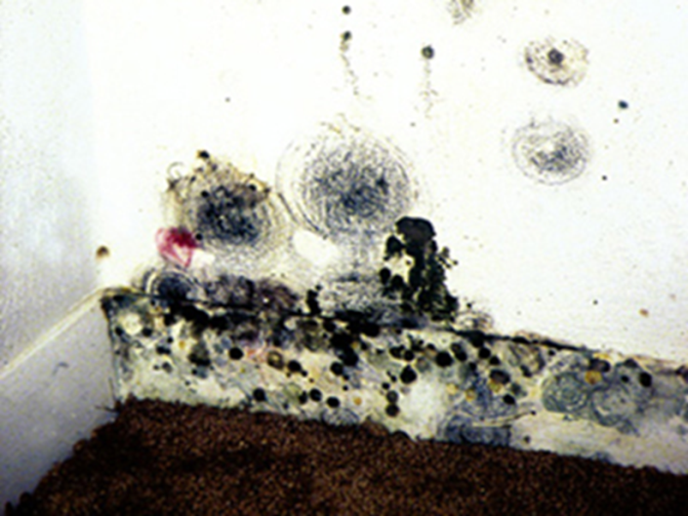
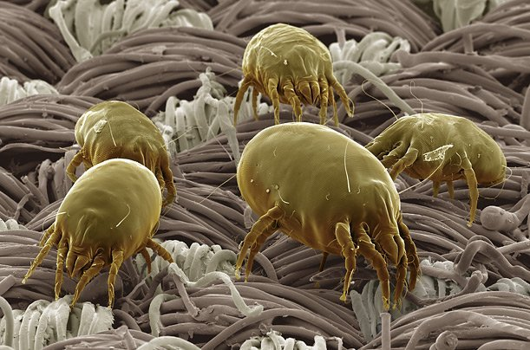
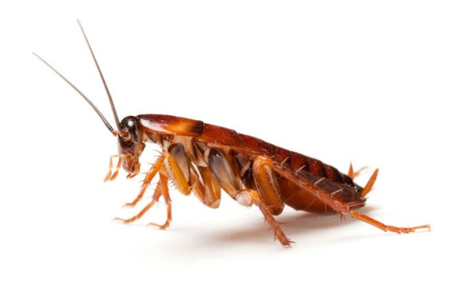
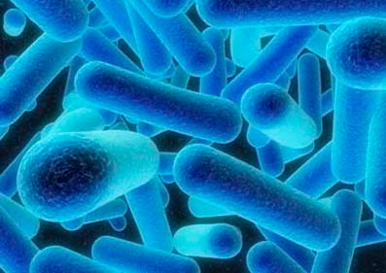
Biological –
Sources -dust mites, insect detritus, mold, bacteria.
Notes:
Dust mites are so small they are not visible to the naked eye. So their waste is even smaller. Insect detritus (waste and dead body parts) is a good source of food for bacteria. You will never get them all, but managing insect pests will contribute to healthy indoor air quality.

Slide 11
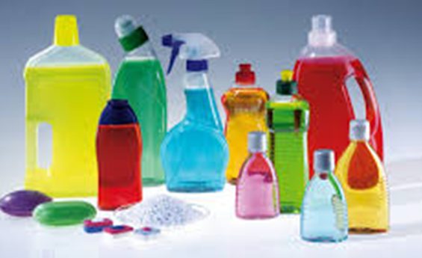
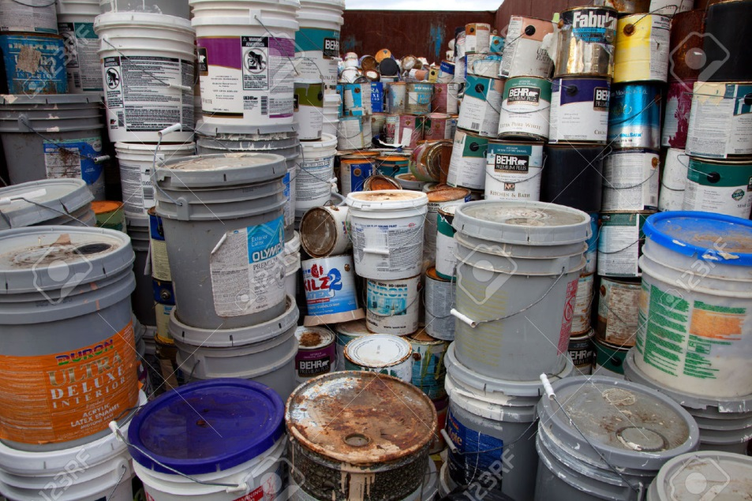
Chemical -
Sources – operations, housekeeping, maintenance.
Notes:
All chemicals in the workplace require Safety Data Sheets be accessible to all employees. The SDS will list known hazards, allowable concentrations and possible controls. Sometimes ‘over cleaning’ becomes a problem for people who may experience reactions to certain chemicals.

Slide 12
Physical–
Sources Particulate matter. (solid, liquid)
Notes:
‘Particulates’ is a plural term for the aggregate of small particles, especially as produced by one source. Mold spores, drywall or paper dust and soot are all examples of particualtes.
.
solid or liquid particles suspended in the atmosphere, especially pollutants.

Slide 13
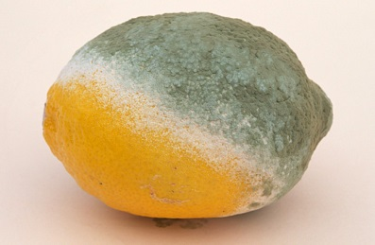
What is ‘Black Mold’ or ‘Toxic Mold’ ?
Stachybotyrus
Aspergillius/Penicillium
Notes:
Toxic – not a good word for daily usage, as ‘the dose makes the poison’ . The term originally referred to Stachybotyrus Chartarum, a type of mold that is known to cause more health issues than more common types. But the less hazardous varieties can also grow black or green, depending on food source and environmental conditions.

Slide 14
MOLD
Notes:
You really cannot tell the type of mold just by looking at it, as most are ‘black’, but the toxicity level varies with type and amount. For example, a person who is allergic to penicillin may get a reaction to penicillium when others feel fine. It is best to take a sample and send to the a lab if you can.

Slide 15
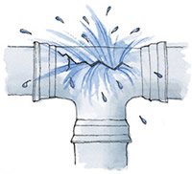
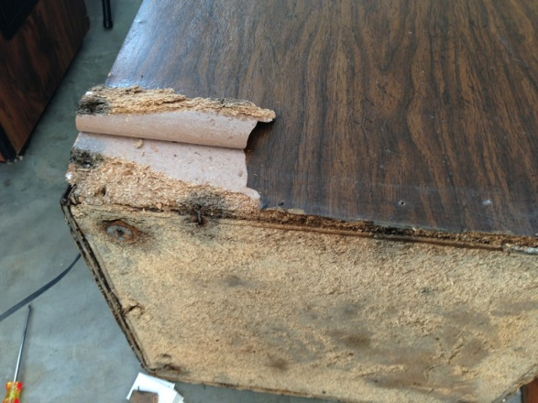
MOLD
Three things required:
Water
Food source
Temperature
Notes:
Water is the main thing. If you ever need to perform mold remediation, remember to identify the source of unwanted moisture, and fix it. Otherwise, the mold will just grow right back again!

Slide 16
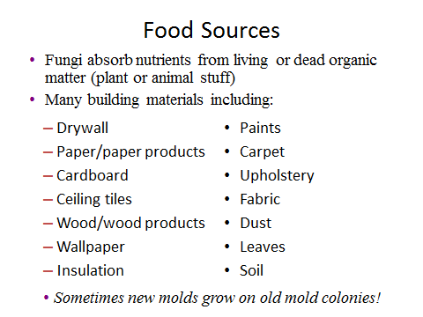
Notes:
Many of these can be found inside a modern office building, or nearby outside.

Slide 17
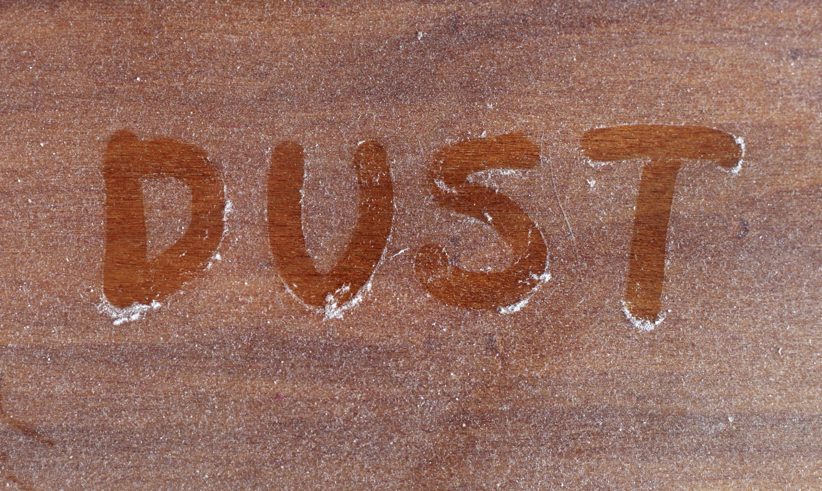
Physical
Notes:
What is dust ? These days, most office dust is dead human skin cells. If you are still using ‘dry toner’ printing, these also generate a lot of particulate matter into the air. A high-volume printing operation will mean paper dust, which is good food source for mold if allowed to accumulate.

Slide 18
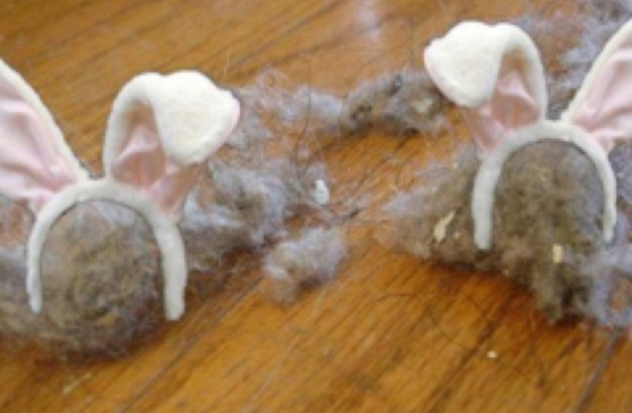
DUST
Dust occasionally
Change filters in HVAC
Manage sources
Vacuum frequently
Notes:
Frequency depends upon sources. (animal dander, paper dust or even dead skin cells from people.) Change filters as recommended by equipment manufacturer.
Vacuum Use HEPA filter or vacuum.
Dust once in a while – a damp cloth is probably best.

Slide 19
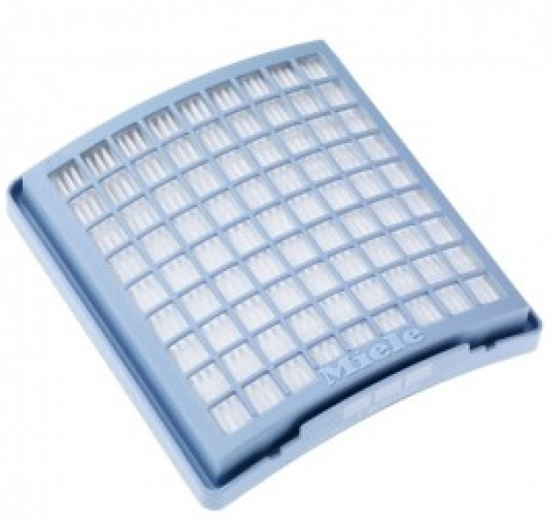
HEPA
High – Efficiency Particulate Arrestor
Removes 99.97% of particles that have a size of 0.3 µm or larger.
Notes:
Do you need it? Just a remember – even the best HEPA vacuum cleaners won’t work if they don’t get taken out of the storage closet at least once a week.

Slide 20
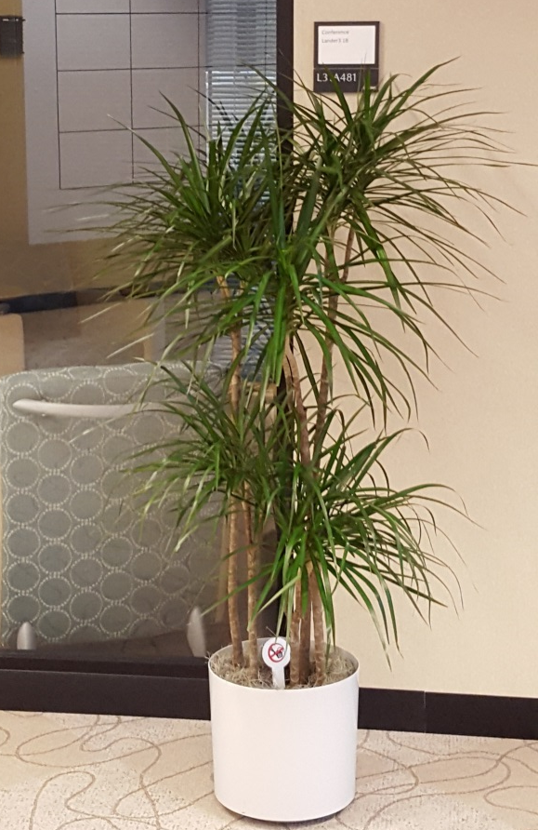
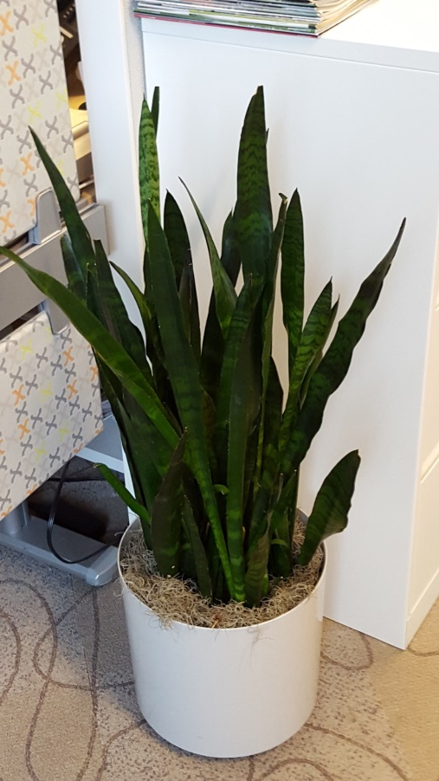
Plants in the office—
Good or bad for IAQ?
Notes:
Dracenas, spider plants, snake plants – they can help remove a little bit of benzene and other VOCs, and freshen stale air with oxygen. Be careful if people bring in house plants from home, as a some plants may be allergenic for other peoples in the area. Plants also require care, and if not cared for properly they will smell or allow mold growth. So a plant service may be best if there is desire for that ‘fresh’ environment.

Slide 21
Possible adverse Health effects.
Allergies
Asthma
Hyper-sensitivity Pneumonitis
‘Comfort’ issues – itchy, water eyes
Skin irritation
Reaction to Volatile Organic Compounds and odors.
Notes:
Even minor health issues such as odors can disrupt productivity.

Slide 22
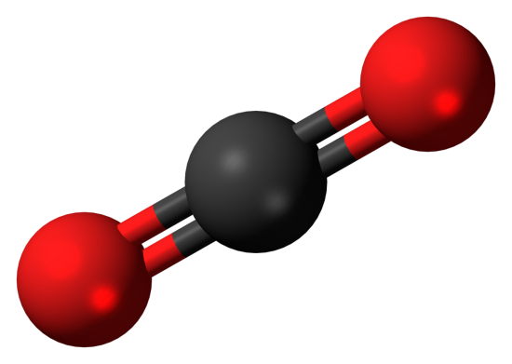
Carbon Dioxide (CO²)
Colorless, odorless gas at room temperature.
Present in exhaled human breath
Combustion by-product
Naturally present in unpolluted environment around 300 ppm
Notes:
CO2 issues can be caused by too many people breathing in a space that is not intended for such high occupancy. Typically, if the indoor concentration is under 1000 ppm, we do not expect issues.

Slide 23
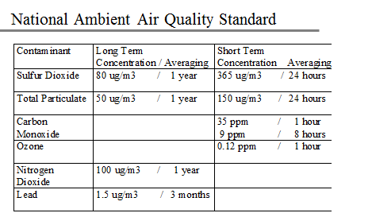
US EPA – Clean Air Act
Notes:
Sometimes EPA standards and OSHA requirements are different. In the workplace, it’s usually best to follow OSHA first.

Slide 24
OSHA standards
(applies to workplace only)
Carbon Dioxide: 5000 ppm PEL
Carbon Monoxide: 50 ppm PEL
VOCs: Various
Mold : NONE
Notes:
PEL = Permissible Exposure Limit.

Slide 25
Carbon Monoxide (CO)
Colorless, odorless, tasteless poisonous gas
Produced as a by-product of combustion
Deprives the body of oxygen by binding to blood hemoglobin and displacing oxygen molecules
Notes:
Do not use gasoline or diesel –powered equipment indoors without adequate ventilation.

Slide 26
The ‘General Duty’ clause
29 U.S.C. § 654, 5(a)1:
“Each employer shall furnish to each of his employees employment and a place of employment which are free from recognized hazards that are causing or are likely to cause death or serious physical harm to his employees."
Notes:
OSHA can enforce IAQ issues via the general duty clause, if they are serious enough.

Slide 27
Notes:
Open Hyperlink :https://www.osha.gov/Publications/3430indoor-air-quality-sm.pdf. This is available for free.

Slide 28
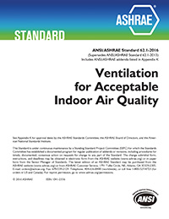
ASHRAE 62.1-2016
American Society of Heating Refrigeration and Air Conditioning Engineers.
Notes:
The definition of Environmental Tobacco Smoke (ETS) now includes both cannabis and e-cigs. (‘vaping’)

Slide 29
Thermal Comfort: Follow ASHRAE standards:
30-60% Relative Humidity (RH)
68-76 degrees F°
Notes:
We can only shoot for a range rather than exact number, as changing outdoor conditions affect IAQ. If most of the occupants are not complaining, think twice before making any adjustments.

Slide 30
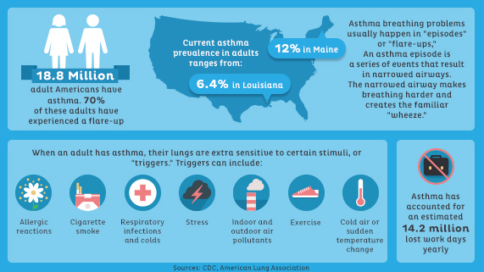
IAQ costs for Business
Source: http://www.healthination.com
Notes:
There has been a huge increase in asthma diagnoses over the past 20 years. Poor IAQ in both home and workplace is believed to contribute significantly to this increase.

Slide 31
Managing IAQ is a ‘team effort’
EHS
Understand laws, standards and safe work practices.
Facilities/maintenance:
Often the first part of the solution, particularly with housekeeping and/or HVAC.
Notes:
Building relationships is an important part of managing IAQ.

Slide 32
Managing IAQ is a ‘team effort’
Human Resources – sometimes the best bet to document or track complaints.
Medical staff- help review individual records
Notes:
Remember HIPPAA rules , and be conscientious regarding ADA requirements. This is why you need teamwork!

Slide 33
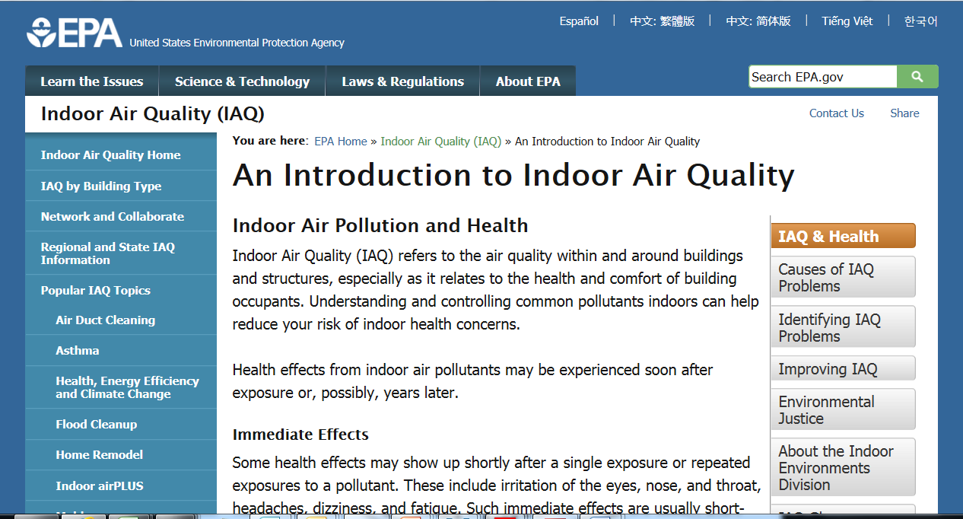
LINK to EPA IAQ page.
Notes:
The EPA and CDC (Center for Disease Control) offer guidance on line for free.

Slide 34
Additional sources:
Burroughs, H.E and Hansen,, Shirley : Managing Indoor Air Quality (3rd edition.) Fairmount Press, Lilburn, GA 2004
Morawska, Lidia and Tunga Salthammer Indoor Environments: Airborne Particles and Dust. Wiley –VCH, Darmstadt, Germany 2003
May, Jeffrey C My Office is Killing Me :The Sick Building Survival Guide. (2nd edition) Johns Hopkins University Press, Baltimore, MD 2006
Notes:
For those who want to dig deeper, here are some great books. May’s is best for the novice.

